Slide 1
Deliverable 4
Gym Modernization
By: Akram Khan, Daniel Cunningham, Pratik Padhiyar, Alek Babecki, Jay Early, and Tom Irwin

Slide 2
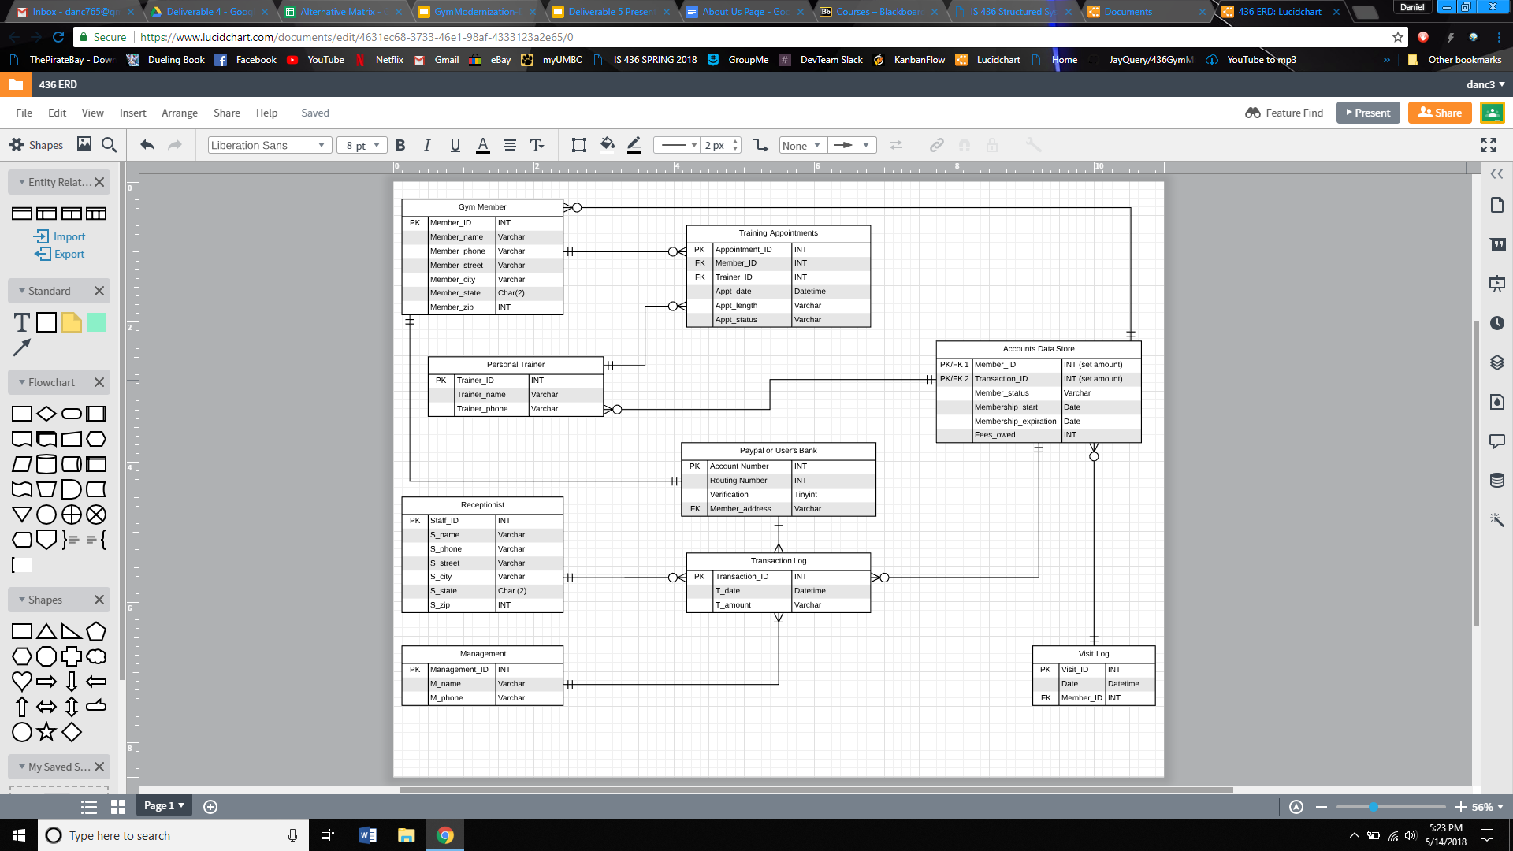
ER Diagram

Slide 3
Text Descriptions of entities and relationships
Gym Member:
Entity describes a member’s personal information. Connects with Paypal table, accounts table, and appointments table.
Personal Trainer:
Entity consists of a trainer’s name and phone. Connected with appointments and accounts table.
Training Appointments:
Attributes such as appointment length and status of appointment. Connected to personal trainer and gym member tables.
Paypal or User’s Bank:
Contains info such as routing number and member_address. Connected to gym member table.
Transaction Log:
Includes a uniquely identified primary key called Transaction_ID along with the actual transaction date & time along with the actual cost amount.

Slide 4
Text Descriptions of entities and relationships
continued
Receptionist: Contains staff personal info as attributes. Accounts Data Store: Has membership access information including fees owned and start/stop time. Visit Log: Contains unique primary key called Visit_ID but also includes the actual date and time of the visit itself along with the Member_ID as the foreign key to recognize who actually visited the gym. Management: Includes Management_ID as primary key along with the management user’s name and phone number.

Slide 5
Alternatives Matrix
https://docs.google.com/spreadsheets/u/1/d/1E3qMEV6JX0RGeSJApnTgosY1o_bErM8ai-GwbPLC_6o/edit?usp=drive_web&ouid=105932616905474530358

Slide 6
Narrative for choosing a web application
Developed using familiar technologies such as PHP, HTML, CSS, Javascript.
Building a web application allows us to run ads and build relationships with customers.
UI can easily be tweaked and updated at will.

Slide 7
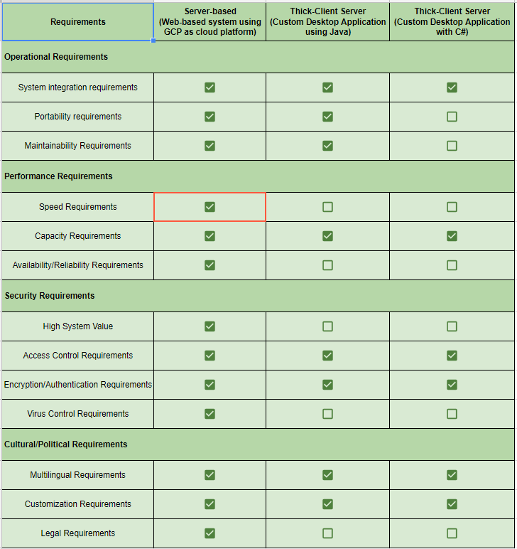
System Architecture Matrix(non-functional requirements)

Slide 8
Justification for System Architecture
Choosing a server based architecture allows us to constantly ping our servers as opposed to a thick or even a thin-client architecture.
Because we have a web application, it is necessary for all of the processing to be handled on the backend through servers and databases hosted on the GCP.
A server based architecture meets all of our nonfunctional requirements.

Slide 9
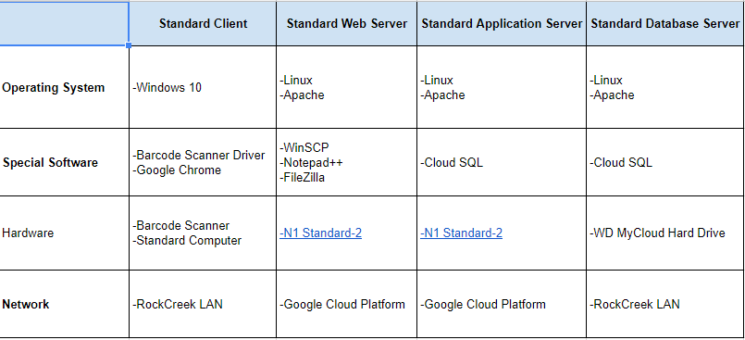
Hardware/Software Specification

Slide 10
Project Work Plan
https://docs.google.com/spreadsheets/d/1ejx_Ox2Rqxv6cPuh-hH_Er3CNOKHGU0_9i3guQB23bU/edit#gid=511849719

Slide 11
Kanban Board
https://kanbanflow.com/board/nyGh4ZN5

